Slide 1
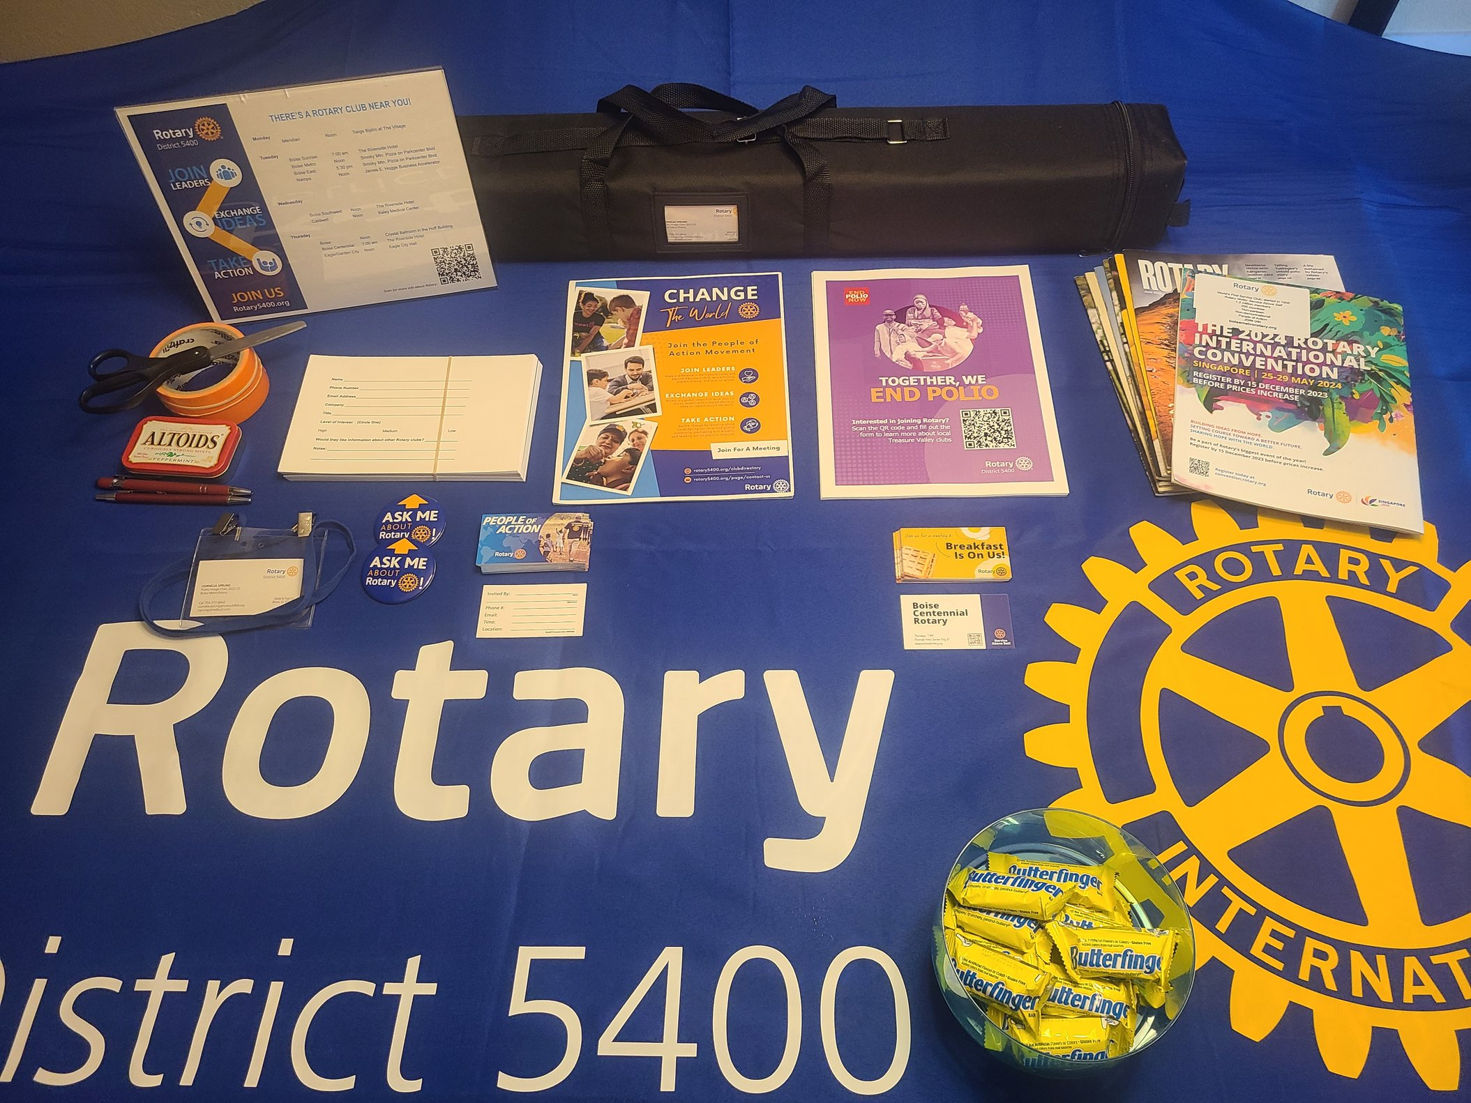
ROTARY TABLETOP MARKETING KIT
Did you know that D5400 has tools to help your club promote Rotary and recruit members at networking events?
1 – List of Rotary clubs in an acrylic stand. Treasure Valley version and district-wide versions you can edit here.
2 – Retractable banner. See next page.
3 – Misc supplies you’ll appreciate.
4 – Forms to gather leads for follow-up. Or create a Google Form like this one.
5 – Flyers and brochures. Create your own club brochure here.
6 – Rotary magazine back-issues. Cover your address with this Avery 5821 label.
7 – Lanyards for a name tag or to hold your business cards. Make your Rotary cards here.
8 – Two ‘Ask Me About Rotary’ buttons
9 – Blank invitation cards to bring a guest to a club meeting
10 – An example of a customized invitation card. A Canva template is here.
11 – Tablecloth to fit an 8’ table
12 – Candy dish
To have this kit shipped to you, just send an email to the Public Image Chair at publicimage@rotary5400.org.
1
2
5
6
3
4
7
9
10
8
12
11

Slide 2
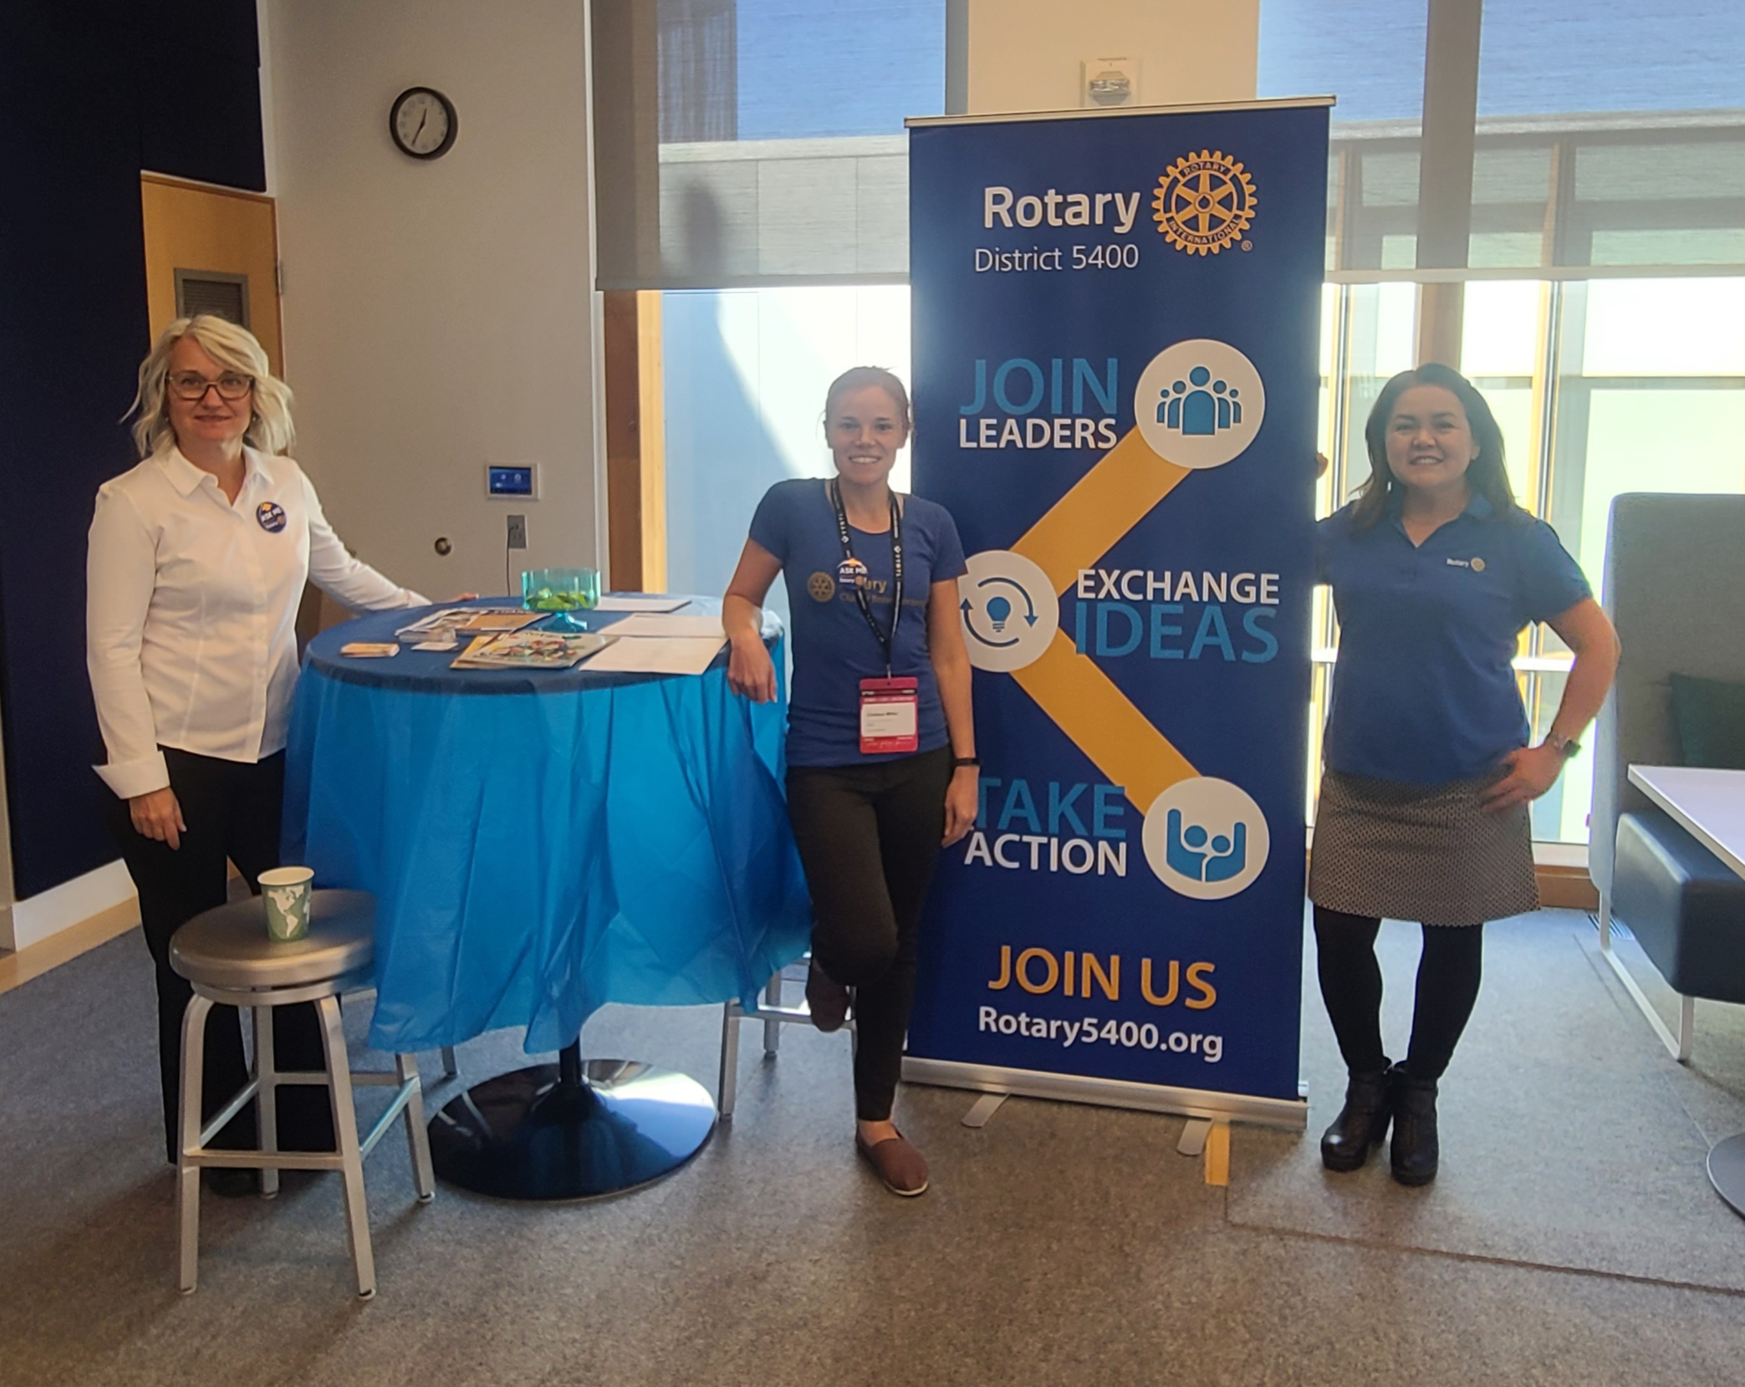
Here’s what the retractable
banner looks like:
Copy the JPG below if you’d like to reuse the graphic.

